Slide 1
Book Reviewscope
Text Technology 2025 project
Hardik, Manuprasad, Navid

Slide 2
Project topic
Amazon reviews are hard to analyse
→ Split reviews into phrases and evaluate sentiment polarity
→ Make them accessible in a SQL Database with book title
Allows for meaningful queries to filter for phrases with positive or negative sentiment by genre or price

Slide 3
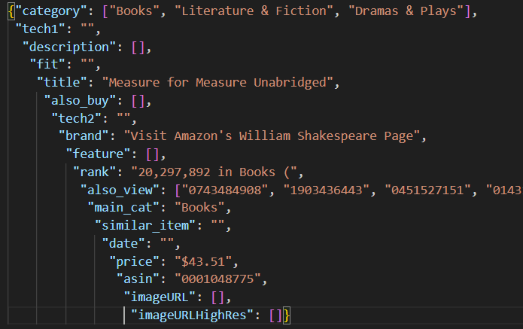
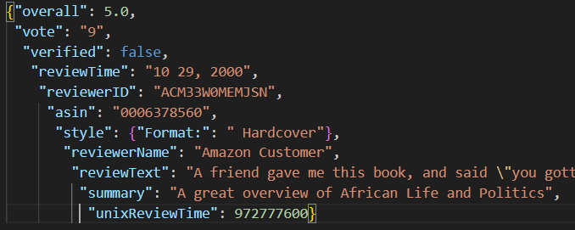
Collect
Take Amazon Book review data from Hou et al. (2024)
Data is in JSON format split into:
  Metadata: Title, Categories, price etc. for all books
  Review data: Chronologically sorted reviews with text, rating, etc.
Review Data
Metadata

Slide 4
Prepare
Merge Metadata into Review Data
Clean JSON files and extract sentences
Calculate sentiment polarity of sentences using VADER score
Incorporate sentiment data into review data
Export to XML and validate against Schema

Slide 5
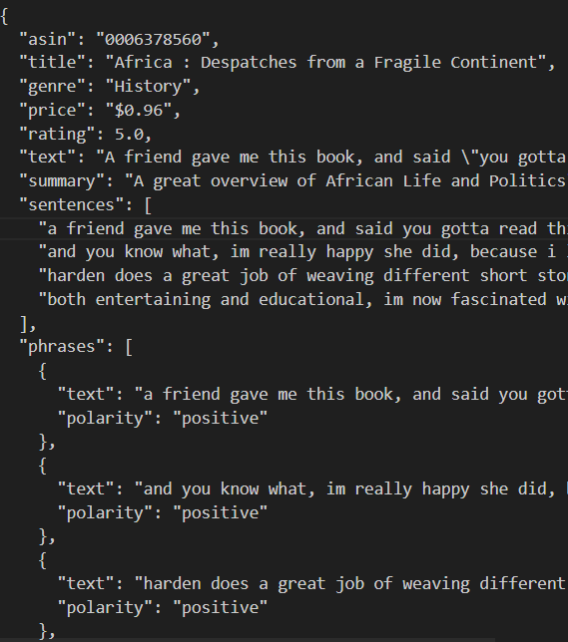
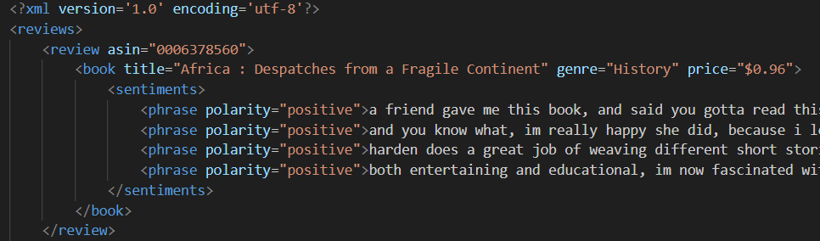
Review Data XML
Review and Polarity Data JSON

Slide 6
Access
Write Data into SQL
3 Tables:
  Book data: Title, Genre, Price
  Reviews: Rating, Review Text, Review Summary
  Sentiments: Phrases, Polarity

Slide 7
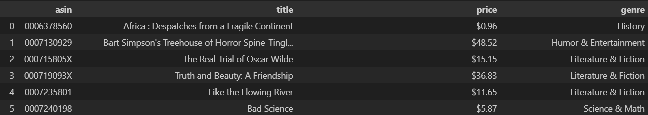
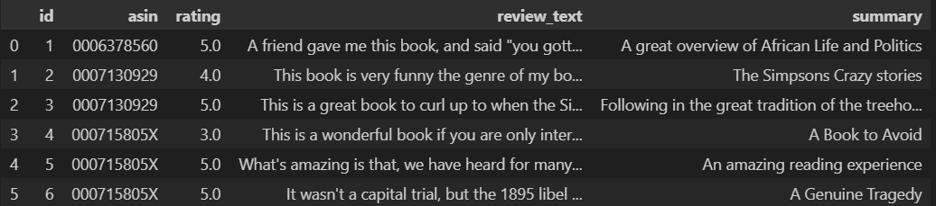
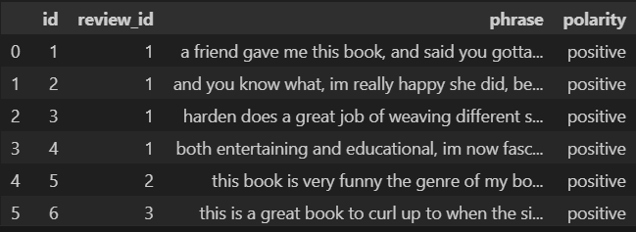
Book Data Table
Review Data Table
Sentiment Data Table

Slide 8
Extension

Slide 9
Difficulties
Very large Dataset
→ Take sensible subset
Every item has different genres (hierarchical)
→ Which level to take?

Slide 10
References
Data:
Hou, Yupeng and Li, Jiacheng and He, Zhankui and Yan, An and Chen, Xiusi and McAuley, Julian (2024). Bridging Language and Items for Retrieval and Recommendation. arXiv:2403.03952
Tools:
Hutto, C.J. & Gilbert, Eric (2014). VADER: A Parsimonious Rule-based Model for Sentiment Analysis of Social Media Text. Eighth International Conference on Weblogs and Social Media (ICWSM-14). Ann Arbor, MI, June 2014.
Bird, Steven and Loper, Edward (2004). NLTK: The Natural Language Toolkit. In Proceedings of the ACL Interactive Poster and Demonstration Sessions, pages 214–217, Barcelona, Spain. Association for Computational Linguistics.

